Slide 1
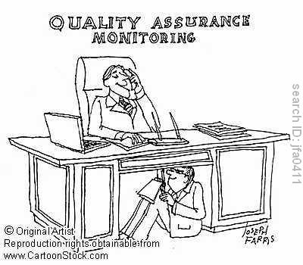
ABHISHEK BHATTACHARYA,IEM

Slide 2
Organization of this Lecture:
Introduction Quality Engineering.
Quality control and Quality Assurance
ISO 9000
SEI CMM
Summary

Slide 3
Quality ???
All of us have had experiences of poor quality product when dealing with business organizations.
These experiences might involve an airline that has lost a passenger’s luggage, or a dry cleaner that has left clothes wrinkled a purchased product that is damaged or broken, or a food home delivery service that is often late or delivers the wrong order

Slide 4
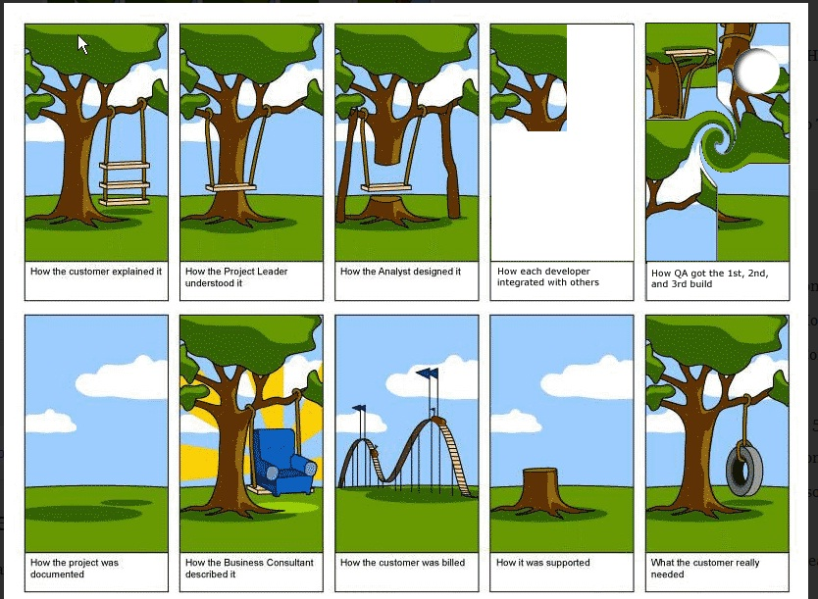

Slide 5
Introduction
Traditional definition of quality:
  fitness of purpose,
    a quality product does exactly what the users want it to do.

Slide 6
Fitness of purpose
For software products,
  fitness of purpose:
    satisfaction of the requirements specified in SRS document.

Slide 7
Fitness of purpose
A satisfactory definition of quality for many products:
  a car, a table fan, a food mixer, microwave oven, etc.
But, not satisfactory for software products.

Slide 8
Introduction
Consider a software product:
  functionally correct,
    i.e. performs all functions as specified in the SRS document,
  but has an almost unusable user interface.
    cannot be considered as a quality product.

Slide 9
Introduction
Another example:
  a product which does everything that users want.
  but has an almost incomprehensible and unmaintainable code.

Slide 10
Modern view of quality
Associates several quality factors with a software product :
  Correctness
  Reliability
  Efficiency (includes efficiency of resource utilization)
  Portability
  Usability
  Reusability
  Maintainability

Slide 11
Correctness
A software product is correct,
  if different requirements as specified in the SRS document have been correctly implemented.
  Accuracy of results.

Slide 12
Portability
A software product is said to be portable,
  if it can be easily made to work in different operating systems,
  in different machines,
  with other software products, etc.

Slide 13
Reusability
A software product has good reusability,
  if different modules of the product can easily be reused to develop new products.

Slide 14
Usability
A software product has good usability,
  if different categories of users (i.e. both expert and novice users) can easily invoke the functions of the product.

Slide 15
Maintainability
A software product is maintainable,
  if errors can be easily corrected as and when they show up,
  new functions can be easily added to the product,
  functionalities of the product can be easily modified, etc.

Slide 16
Software Quality Management System
Quality management system (or quality system):
  principal methodology used by organizations to ensure that the products have desired quality.

Slide 17
Quality system
A quality system consists of the following:
  Managerial Structure
  Individual Responsibilities.
Responsibility of the organization as a whole.

Slide 18
Quality system
Every quality conscious organization has an independent quality department:
  performs several quality system activities.
  needs support of top management.
  Without support at a high level in a company,
    many employees may not take the quality system seriously.

Slide 19
Quality System Activities:
Auditing of projects
Development of:
  standards, procedures, and guidelines, etc.
Production of reports for the top management
  summarizing the effectiveness of the quality system in the organization.
Review of the quality system itself.

Slide 20
Quality system
A good quality system must be well documented.
  Without a properly documented quality system,
    application of quality procedures become ad hoc,
    results in large variations in the quality of the products delivered.

Slide 21
Quality system
An undocumented quality system:
  sends clear messages to the staff about the attitude of the organization towards quality assurance.
International standards such as ISO 9000 provide:
  guidance on how to organize a quality system.

Slide 22
Evolution of Quality Systems
Quality systems have evolved:
  over the last five decades.
Prior to World War II,
  way to produce quality products:
    inspect the finished products
    eliminate defective products.

Slide 23
However,in the 1970s and 1980s many U.S. industries lost market share to foreign competition.
In the auto industry, manufacturers such as Toyota and Honda became major players.
In the consumer goods market, companies such as Toshiba and Sony led the way.

Slide 24
These foreign competitors were producing lower-priced products with considerably higher quality. So to survive, companies had to make major changes in their quality programs.

Slide 25
Evolution of Quality Systems
Since that time,
  quality systems of organizations have undergone
    four stages of evolution.

Slide 26
Evolution of Quality Systems

Slide 27
Evolution of Quality Systems
Initial product inspection method :
  gave way to quality control (QC).
Quality control:
  not only detect the defective products and eliminate them
  but also determine the causes behind the defects.

Slide 28
Quality control (QC)
Quality control aims at correcting the causes of errors:
  not just rejecting defective products.
Statistical quality control
  quality of the output of the process is inferred using statistical methods
  in stead of inspection or testing of all products

Slide 29
Quality control (QC)
The next breakthrough,
QC does not determine only the defective products but it also finds out the reasons behind the defects or faults.
So naturally the production rejection rate would be eliminated.
  development of quality assurance principles

Slide 30
Quality assurance
Basic premise of modern quality assurance:
  if an organization's processes are good and are followed rigorously,
    the products are bound to be of good quality.

Slide 31
Quality assurance
All modern quality paradigms include:
  guidance for recognizing, defining, analyzing, and improving the production process.

Slide 32
Comparisons of QA and QC
i) QA consists of a set of functions that check and report the effectiveness and completeness of quality control activities.
QC consists of a set of functions of inspections, reviews and tests used throughout the software process ensuring each work product meets the requirement.

Slide 33
ii) The goal of QA is to provide management with the data necessary to be informed about product quality and the factors considered towards measuring quality of the software are –correctness, maintainability, usability, integrity.
The key concept of QC is to determine the defective products but it also finds out the reasons behind the defects or faults.

Slide 34
QA is process oriented and QC is product oriented.

Slide 35
Product vs. Process Metrics:
There are some metrics which are called product metrics and they are basically concerned about the product being developed.
But on the other hand some metrics are based on measuring the performances of the process.
Product metrics describe the characteristics of the product such as size, complexity, design features, performance and quality level. LOC, function points are the example of Process metrics can be used to improve software development and maintenance.

Slide 36
Total quality management (TQM)
Advocates:
  continuous process improvements through process measurements.

Slide 37
Total quality management (TQM)
TQM goes beyond documenting processes
  optimizes them through redesign.
Over the years the quality paradigm has shifted:
  from product assurance to process assurance.

Slide 38
        Quality Standards

Slide 39
ISO 9000
ISO (international Standards Organization):
  a consortium of 63 countries established to formulate and foster standardization.
ISO published its 9000 series of standards in 1987.

Slide 40
ISO 9000 is by far the world’s most established quality framework, currently being used by 1,064,000 organizations in 178 countries worldwide, and sets the standard not only for quality management systems, but management systems also in general.
It was based on the BS 5750 series of standards from British Standards Institution (BSI) that were proposed to ISO in 1979.

Slide 41
What is ISO 9000 Certification?
ISO 9000 certification:
  serves as a reference for contract between independent parties.
The ISO 9000 standard:
  specifies guidelines for maintaining a quality system.

Slide 42
What is ISO 9000 Certification?
ISO 9000 specifies:
  guidelines for repeatable and high quality product development.
  Also addresses organizational aspects
    responsibilities, reporting, procedures, processes, and resources for implementing quality management.

Slide 43
ISO 9000
A set of guidelines for the production process.
  not directly concerned about the product it self.
  a series of three standards:
    ISO 9001, ISO 9002, and ISO 9003.

Slide 44
ISO 9000
Based on the premise:
  if a proper process is followed for production:
    good quality products are bound to follow.

Slide 45
ISO 9001:
Applies to:
  organizations engaged in design, development, production, and servicing of goods.
  applicable to most software development organizations.

Slide 46
ISO 9002:
ISO 9002 applies to:
  organizations who do not design products:
    but are only involved in production.
Examples of this category of industries:
  steel or car manufacturing industries
  buy the product and plant designs from external sources:
    only manufacture products.
  not applicable to software development organizations.

Slide 47
ISO 9003
ISO 9003 applies to:
  organizations involved only in installation and testing of the products.

Slide 48
ISO 9000 for Software Industry
ISO 9000 is a generic standard:
  applicable to many industries,
    starting from a steel manufacturing industry to a service rendering company.
Many clauses of ISO 9000 documents:
  use generic terminologies
  very difficult to interpret them in the context of software organizations.

Slide 49
Software vs. other industries
Very difficult to interpret many clauses for software industry:
  software development is radically different from development of other products.

Slide 50
Software vs. other industries
Software is intangible
  therefore difficult to control.
    It is difficult to control anything that we cannot see and feel.
  In contrast, in a car manufacturing unit:
    we can see a product being developed through stages such as fitting engine, fitting doors, etc.
    one can accurately tell about the status of the product at any time.
  Software project management is an altogether different ball game.

Slide 51
Software vs. other industries
During software development:
  the only raw material consumed is data.
For any other product development:
  Lot of raw materials consumed
    e.g. Steel industry consumes large volumes of iron ore, coal, limestone, etc.
ISO 9000 standards have many clauses corresponding to raw material control .
    not relevant to software organizations.

Slide 52
Software vs. other industries
Radical differences exist between software and other product development,
  difficult to interpret various clauses of the original ISO standard in the context of software industry.

Slide 53
Why Get ISO 9000 Certification?
Several benefits:
  Confidence of customers in an organization increases
    if organization qualified for ISO 9001 certification.
    This is especially true in the international market.

Slide 54
Why Get ISO 9000 Certification?
Many international software development contracts insist:
  development organization to have ISO 9000 certification.
  Encourages internal communication and raises morale
  Streamlines operations and reduces waste.

Slide 55
Why Get ISO 9000 Certification?
Attracts investment, enhances brand reputation and removes barriers to trade
  Certification to ISO 9001 will boost the organization’s brand reputation and can be a useful in advertisement and promotional purpose.
Saves money
  Evidence shows that the financial benefits for companies that have invested in and certified their quality management systems to ISO 9001 include operational efficiencies, increased sales, higher return on assets, ROI.

Slide 56
Why Get ISO 9000 Certification?
Requires:
  a well-documented software production process to be in place.
  contributes to repeatable and higher quality software.
Makes development process:
  focussed, efficient, and cost-effective

Slide 57
Why Get ISO 9000 Certification?
Points out the weakness of an organizations:
  recommends remedial action.
Sets the basic framework:
  for development of an optimal process and TQM.

Slide 58
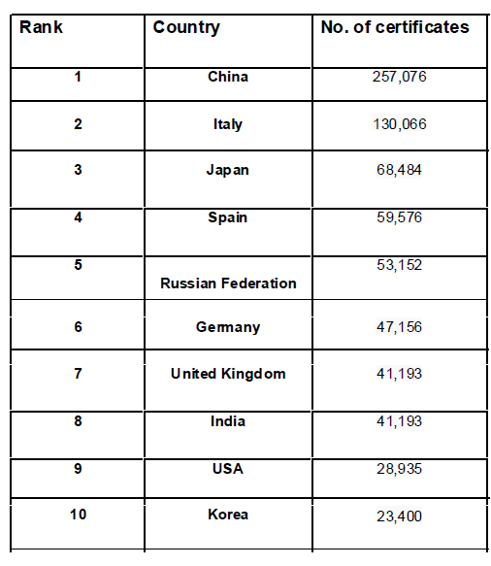
GLOBAL USE OF ISO 9000

Slide 59
How to Get ISO 9000 Certification?
An organization intending to obtain ISO 9000 certification:
  applies to a ISO 9000 registrar for registration.
ISO 9000 registration process consists of several stages.

Slide 60
How to Get ISO 9000 Certification?
Application stage:
  Applies to a registrar for registration.
Pre-assessment:
  the registrar makes a rough assessment of the organization.

Slide 61
How to Get ISO 9000 Certification?
Document review and adequacy audit:
  process and quality-related documents.
  the registrar reviews the documents
  makes suggestions for improvements.

Slide 62
How to Get ISO 9000 Certification?
Compliance audit: the registrar checks
  whether the suggestions made by it during review have been complied.

Slide 63
How to Get ISO 9000 Certification?
Registration:
  The registrar awards ISO 9000 certificate after successful completions of all previous phases.
Continued surveillance:
  The registrar continues monitoring the organization periodically.

Slide 64
ISO 9000 Certification
An ISO certified organization
  can use the certificate for corporate advertizements
  cannot use the certificate to advertize products.
    ISO 9000 certifies organization's process
    not any product of the organization.
  An organization using ISO certificate for product advertizements:
    risks withdrawal of the certificate.

Slide 65
Shortcomings of ISO 9000 Certification (3)
Organizations qualifying for ISO 9001 certification:
  tend to downplay domain expertise.
  tend to believe that since a good process is in place,
    any engineer is as effective as any other engineer in doing any particular activity relating to software development.

Slide 66
Shortcomings of ISO 9001 Certification (4)
In manufacturing industry
  clear link between process quality and product quality
  once a process is calibrated:
    can be run again and again producing quality goods
Software development is a creative process:
  individual skills and experience is significant

Slide 67
Shortcomings of ISO 9000 Certification (5)
Many areas of software development are very specialized:
  special expertize and experience (domain expertize) required.

Slide 68
Shortcomings of ISO 9000 Certification (6)
ISO 9000 addresses mostly management aspects.
Techniques specific to software development have been ignored
  Configuration management
  Reviews
  Release builds
  Problem Notification system
  Intranets

Slide 69
ISO / IEC 20000 IT Service Management Standard
ISO/IEC 20000 is the first worldwide standard specifically aimed at IT Service Management. It describes an integrated set of management processes for the effective delivery of services to the business and its customers.

Slide 70
ISO 27001 - Information Security Management Standard (ISMS)
ISO 27001 is a specification for the management of Information Security. It is applicable to all sectors of industry and commerce and not confined to information held on computers. The information may be printed on paper, stored electronically, transmitted by post or email, shown on films, or spoken in conversation.

Slide 71
ISO 10002 – Customer Satisfaction Standard
ISO 10002 provides guidance on the process of complaints handling related to products within an organization, including planning, design, operation, maintenance and improvement. ISO 10002 is not applicable to disputes referred for resolution outside the organization or for employment-related disputes.

Slide 72
